Slide 1


bme
By – chandana mn
Directed by-prof. divya deepak

Slide 2
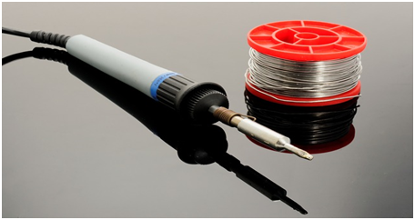



soldering

Slide 3
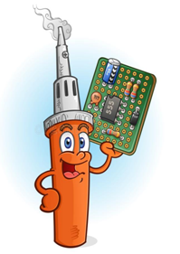
What is soldering ?
Soldering is a joining process used to join different types of metals together by melting solder.

Slide 4
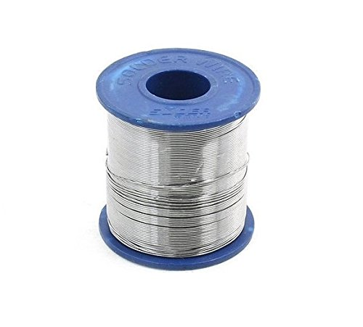
What Is Solder?
It’s a fusible alloy with low melting point used to bond metal workpieces together.
It create a permanent bond between metal workpieces.

Slide 5
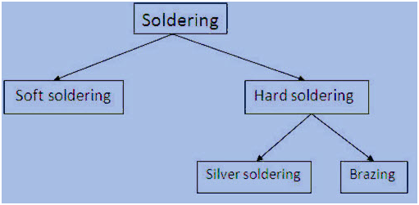

Slide 6
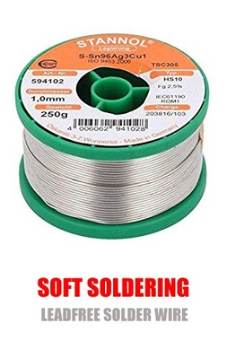
Soft soldering
Soldering using temperatures up to 450°C, is termed soft soldering.
Soft solder typically has a melting point range of 90 to 450 °C (190 to 840 °F; 360 to 720 K)
Commonly used in electronics, plumbing, and sheet metal work.
Alloys that melt between 180 and 190 °C (360 and 370 °F; 450 and 460 K) are the most commonly used.

Slide 7
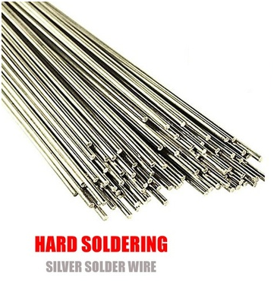
hard soldering
. Soldering performed using alloys with a melting point above 450 °C (840 °F; 720 K) is called "hard soldering".
It can also be called as "silver soldering", or "brazing".
used to join precious and semi-precious metals such as gold, silver, brass, and copper.

Slide 8
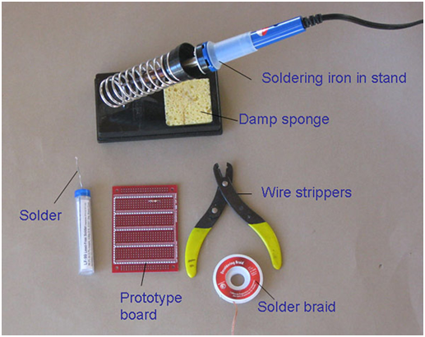
Soldering tools

Slide 9
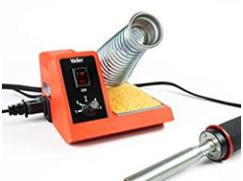
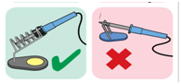
Soldering iron stand

Slide 10
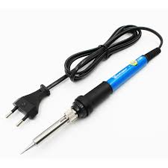
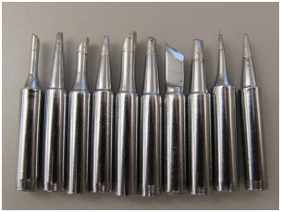
Soldering rod /soldering iron
Works typicaly at 25-30 watts
The tip temperature is till 400 c

Slide 11
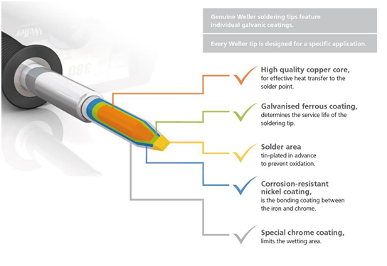

Slide 12
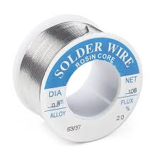
solder
Solder is a metal alloy usually made of tin and lead which is melted using a hot iron
Solder is melted in order to adhere to and connect the pieces after cooling.
solder have a lower melting point than the pieces being joined.
Soft solder typically has a melting point range of 90 to 450 °C (190 to 840 °F; 360 to 720 K).
For most electronics work, solder in the range of 0.4 - 1.0 mm in diameter will work well.

Slide 13
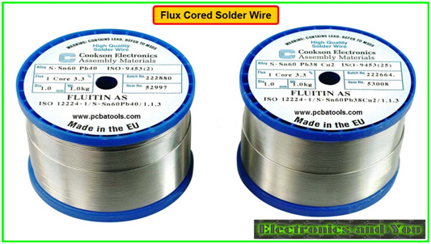
Cont.
There are three commonly used lead-based alloys for electronic soldering:
60/40 (Sn/Pb). ...
63/37 (Sn/Pb). ...
62/36/2 (Sn/Pb/Ag).

Slide 14
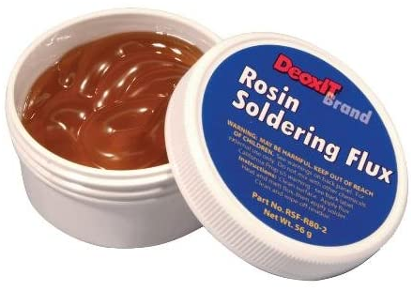
flux
Flux is a chemical compound
It is applied on the joint surface to shield it from air and to prevent it from forming oxides
Zinc chloride is the flux that is commonly used in soft solder.
One more common fluxe is ammonium chloride or resin acids (contained in rosin) for soldering copper and tin

Slide 15
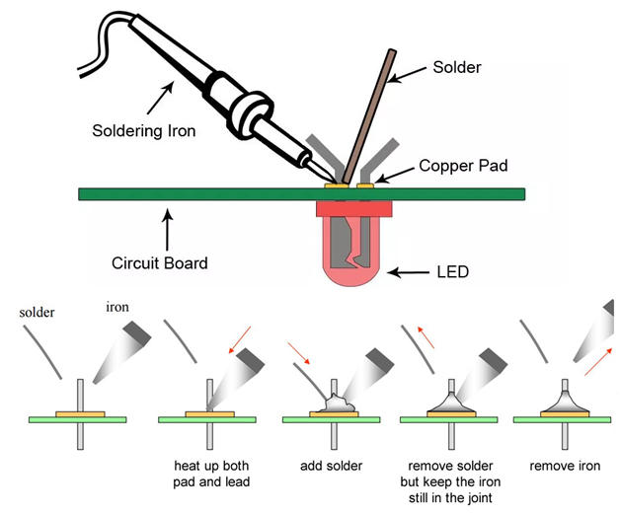
Process of sldering

Slide 16
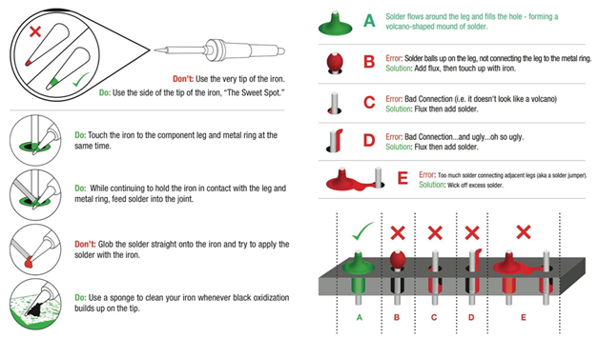
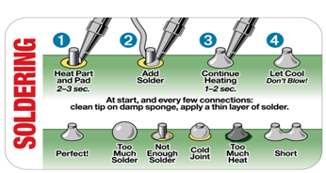

Slide 17
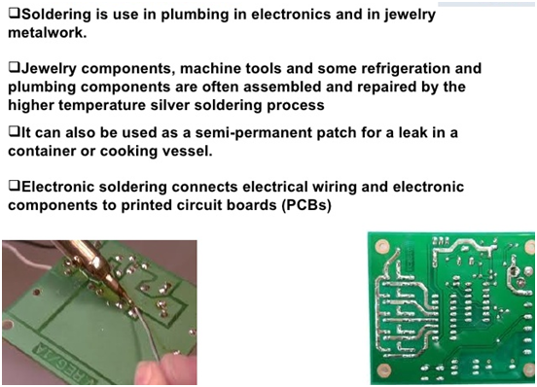
Applications of soldering

Slide 18
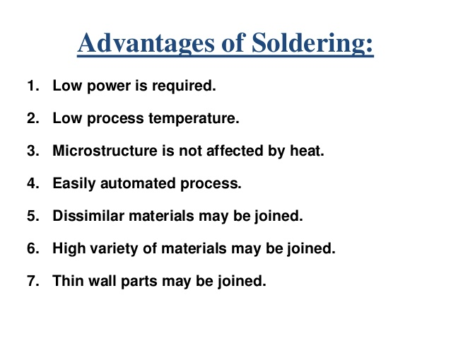

Slide 19
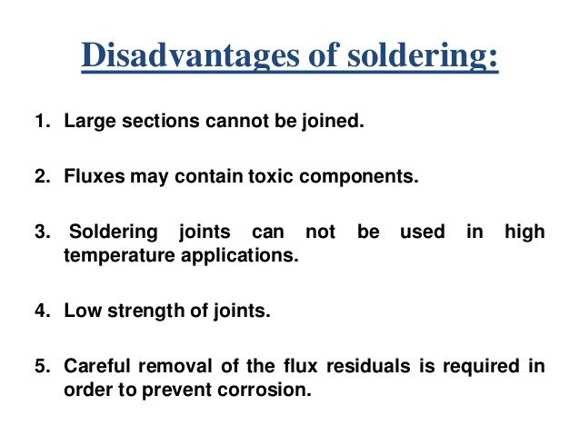

Slide 20
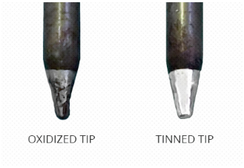
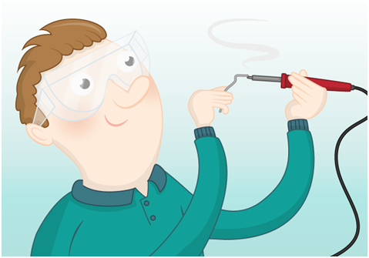
tinning
Tinning the tip extends the life of the tip by preventing oxidation and corrosion, but it also causes the solder wire to melt and flow more easily over the parts you are joining, making the overall soldering process go smoothly.

Slide 21
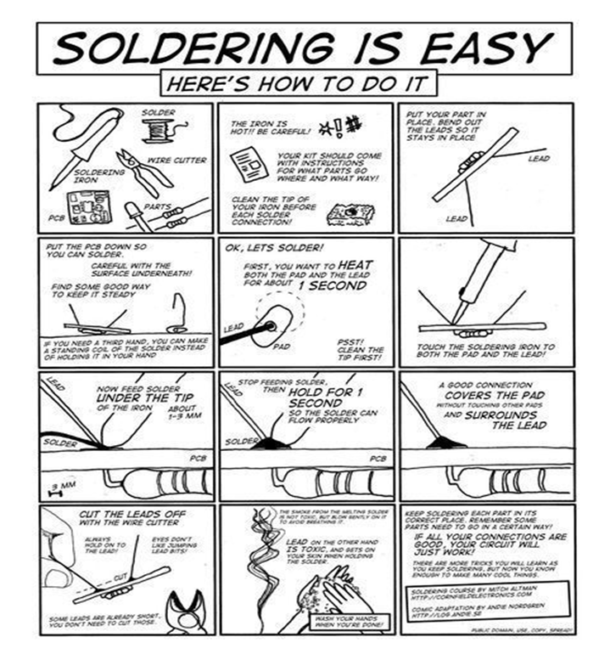
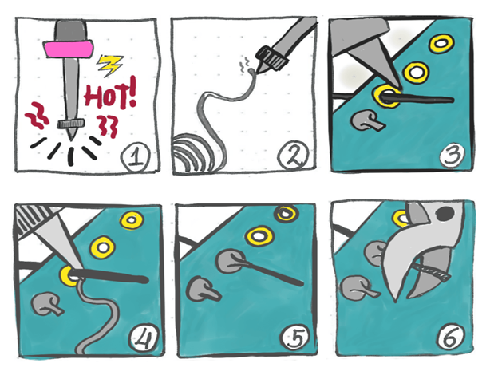
Thank you

